Slide 1

HYPERPARAMETER SEARCH

Slide 2
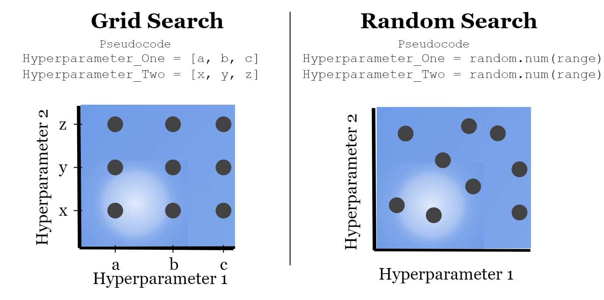
TWO ALGORITHMS: GRID SEARCH & RANDOM SEARCH

Slide 3
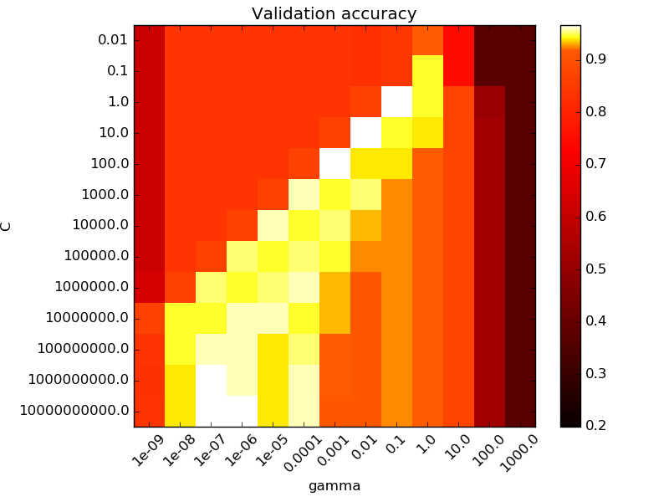
GRID SEARCH

Slide 4
GRID SEARCH
If you have N Parameters
Each parameter can take a finite set of values
You can simply try out training the model with all the possible combinations of the hyperparameters

Slide 5
RANDOM SEARCH
If you have N Parameters
Each parameter can take a finite set of values
You can say: I want X random combinations of the possible values

